Slide 1
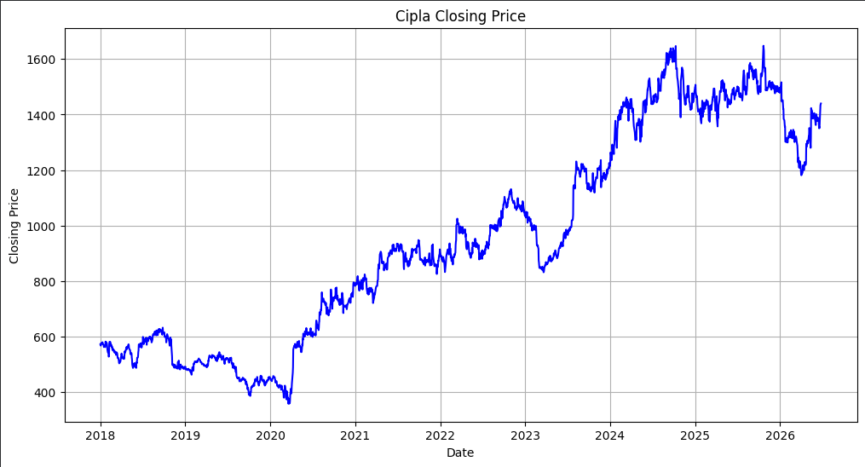





STOCK PRICE FORECASTING
Cipla Ltd. — Using LSTM & DeepAR
A comparative deep-learning and probabilistic forecasting study on India's leading pharmaceutical stock (CIPLA.NS)
Company Overview
Dataset
Cipla Opening Price (2018–2026)
One of India's leading pharmaceutical companies
Founded in 1935 by Dr. Khwaja Abdul Hamied
Headquarters: Mumbai, Maharashtra
Operates in more than 80 countries
Listed on NSE (CIPLA.NS) and BSE
Long trading history — ideal for time-series forecasting
SOURCE
Yahoo Finance
TICKER
CIPLA.NS
PERIOD
Jan '18 – Jun '26
Key Therapeutic Areas
VARIABLE
Opening Price
Respiratory
Cardiology
Oncology
HIV/AIDS
Diabetes
2,096
trading days
Notes:
Good morning. My project is on stock price forecasting using deep learning and probabilistic forecasting techniques. I selected Cipla Limited because it is one of India's largest pharmaceutical companies with a long trading history and stable stock market data. I downloaded the daily closing prices from Yahoo Finance covering January 2018 to June 2026, giving me 2096 trading day observations. The objective of my project was to forecast the next seven trading days using two different models: LSTM and DeepAR, and compare their forecasting performance.

Slide 2




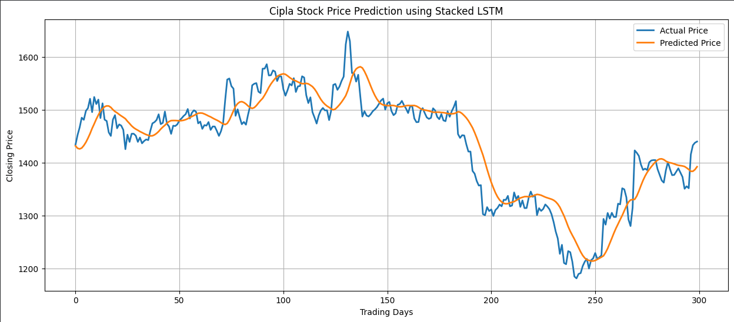
MODEL 1
Stacked LSTM — Direct Price Prediction
→
→
→
→
Input
(Prev 120 days)
MinMax
Scaler
LSTM 50
+ Dropout 0.2
LSTM 50
+ Dropout 0.2
Dense (1)
Output Price
Actual vs Predicted Closing Price
Hyperparameters
Performance Metrics
Optimizer | Adam
Learning Rate | 0.0005
Epochs | 20
Batch Size | 32
Train/Test Split | 80% / 20%
Early Stopping | Patience = 10
36.94
28.33
RMSE
MAE
2.00%
0.8650
MAPE
R²
LSTM demonstrates strong predictive performance by directly forecasting closing prices from normalized historical data.
Notes:
For the first model, I used a stacked LSTM network. Before training, I normalized the closing prices using MinMaxScaler and divided the dataset into 80 percent training and 20 percent testing. The input to the model was the previous 120 trading days, which were used to predict the next day's closing price. The architecture consists of two LSTM layers with 50 neurons each, followed by dropout layers to reduce overfitting and a dense output layer. The model was trained for 20 epochs using the Adam optimizer with a learning rate of 0.0005. The model achieved an RMSE of 36.94, MAE of 28.33, MAPE of 2 percent, and an R-squared value of 0.865, indicating good predictive performance.

Slide 3
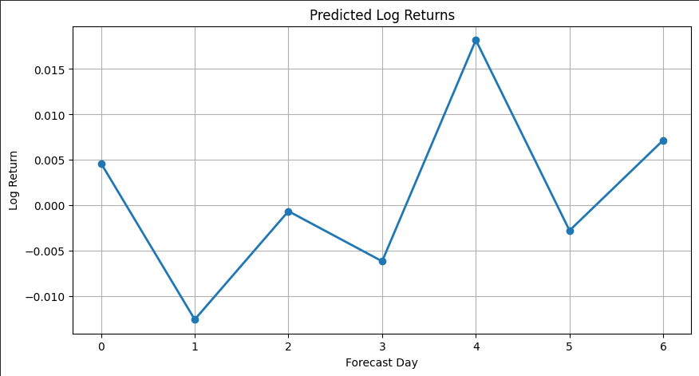
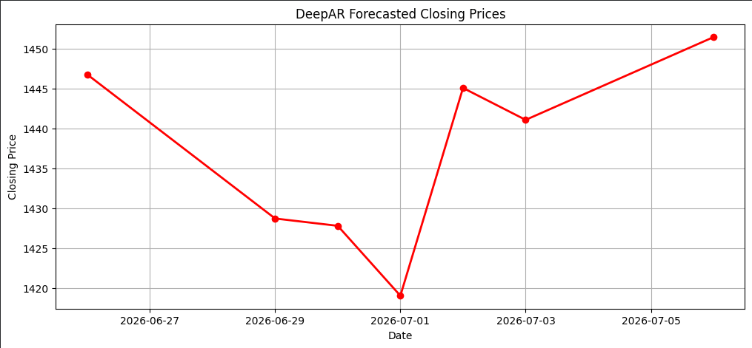
MODEL 2
DeepAR — Probabilistic Forecasting via GluonTS
Why DeepAR?
Forecasting Pipeline
LSTM predicts:
Opening Price directly
DeepAR predicts:
Daily Log Returns (→ converted to price)
Historical
Prices
→
Log
Returns
→
PyTorch
(GluonTS)
→
Pred.
Returns
→
Opening
Prices
Architecture & Parameters
Predicted Log Returns
DeepAR Forecasted Prices
Framework | PyTorch (GluonTS)
Context Length | 120
Prediction Length | 7
Hidden Size | 50
Recurrent Layers | 2
Batch Size | 32
Learning Rate | 0.001
Dropout | 0.20
Distribution | Student-T
Epochs | 100
Performance (Log-Return Scale)
Metrics are on the log-return scale and are not directly comparable with LSTM's price-scale metrics.
0.0225 RMSE
0.0156 MAE
1.98% MAPE
-0.568 R²
Notes:
The second model used in my project was DeepAR. Unlike LSTM, DeepAR predicts daily log returns instead of directly forecasting stock prices. The log returns were later converted back into closing prices for comparison. I implemented DeepAR using the GluonTS library with the PyTorch backend. The model used a context length of 120 trading days and predicted the next seven trading days. It consisted of two recurrent layers with a hidden size of 50, a dropout rate of 20 percent, and a Student-T probability distribution. Since DeepAR predicts returns rather than prices, the evaluation metrics are on a different scale and are not directly comparable with the LSTM metrics.

Slide 4
RESULTS
7-Day Forecast Comparison: LSTM vs DeepAR
Date | LSTM (₹) | DeepAR (₹)
26-Jun-2026 | 1399.12 | 1446.78
29-Jun-2026 | 1403.99 | 1428.72
30-Jun-2026 | 1407.83 | 1427.80
01-Jul-2026 | 1410.94 | 1419.04
02-Jul-2026 | 1413.56 | 1445.08
03-Jul-2026 | 1415.83 | 1441.08
06-Jul-2026 | 1417.86 | 1451.46
Observations
Both models successfully forecasted the next 7 trading days
LSTM predicts Opening price directly; DeepAR predicts log returns, converted back to price
DeepAR forecasts are generally higher than LSTM over the horizon
Both models indicate a relatively stable to slightly increasing price trend
Notes:
Both models successfully forecasted the next 7 trading days. LSTM predicts the closing price directly from historical prices, while DeepAR predicts daily log returns which are then converted back into closing prices. Looking at the results, the DeepAR forecasts are generally higher than the LSTM forecasts over the forecast horizon, though both models indicate a relatively stable to slightly increasing price trend for Cipla over the next seven trading days.

Slide 5

CONCLUSION
Diagnostic Insights & Conclusion
Diagnostic Insights
Approach Difference
Forecast Delta
Historical Edge
LSTM predicts closing prices directly; DeepAR predicts daily log returns for a probabilistic perspective.
Both models indicate a stable to slightly increasing trend; DeepAR projects generally higher valuations.
LSTM demonstrated superior performance for direct historical closing-price prediction.
Implemented two forecasting models — LSTM (TensorFlow/Keras) and DeepAR (GluonTS/PyTorch) — and compared their 7-day forecasts for Cipla Ltd.
2
7
86.5%
2.00%
Models Compared
Day Forecast Horizon
LSTM R² Score
LSTM MAPE
Notes:
Successfully implemented two forecasting models: LSTM using TensorFlow/Keras and DeepAR using GluonTS with PyTorch. I compared the 7-day forecasts generated by both models. LSTM demonstrated strong performance for direct closing-price prediction, while DeepAR provided a probabilistic forecasting approach based on log returns, offering an alternative perspective on future price movement. Going forward, I plan to enrich the feature set with technical indicators like RSI, MACD, and moving averages, and explore Transformer-based architectures for more advanced sequence modeling.

